Slide 1
VU TAY PRIMARY SCHOOL
WELCOME TO OUR CLASS 4
Teacher: Le Thi Thanh Tam

Slide 2
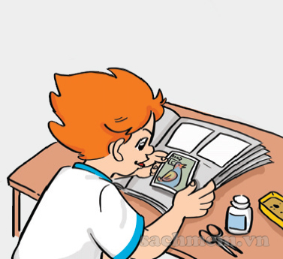
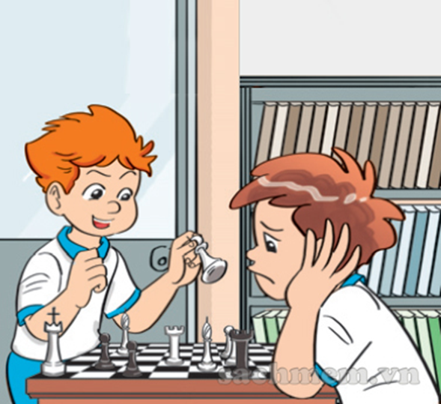
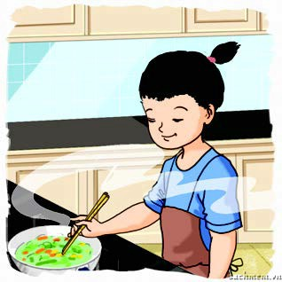
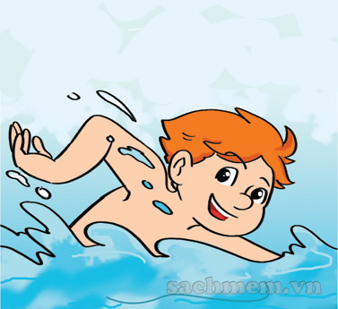
Check old lesson
playing chess
collecting stamps
cooking
swimming

Slide 3
P. 48
Unit 7: What do you like doing?
Lesson 2: Part: 1-2- 3
1. Look, listen and repeat.
2. Point and say.
3. Let’s talk.

Slide 4
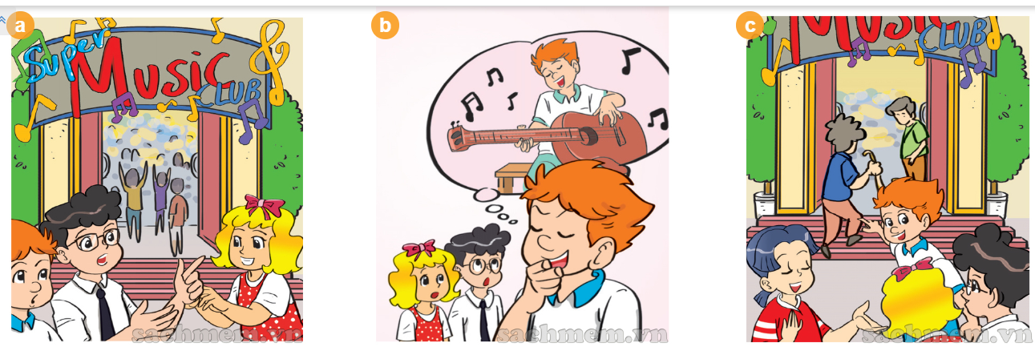
P. 48
Unit 7: What do you like doing?
Lesson 2: Part: 1-2- 3
1. Look, listen and repeat.
Playing the guitar is my hobby.
I like singing.
What’s your hobby, Linda?
Well, we all like music. Let’s go to Super Music Club.
I like playing the piano.

Slide 5
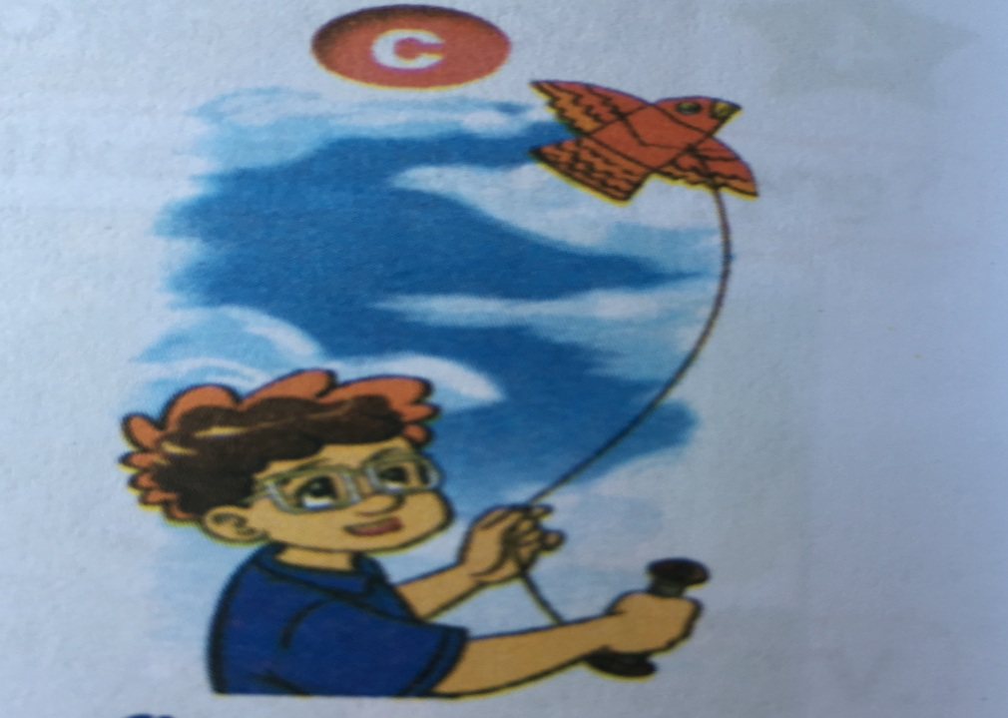
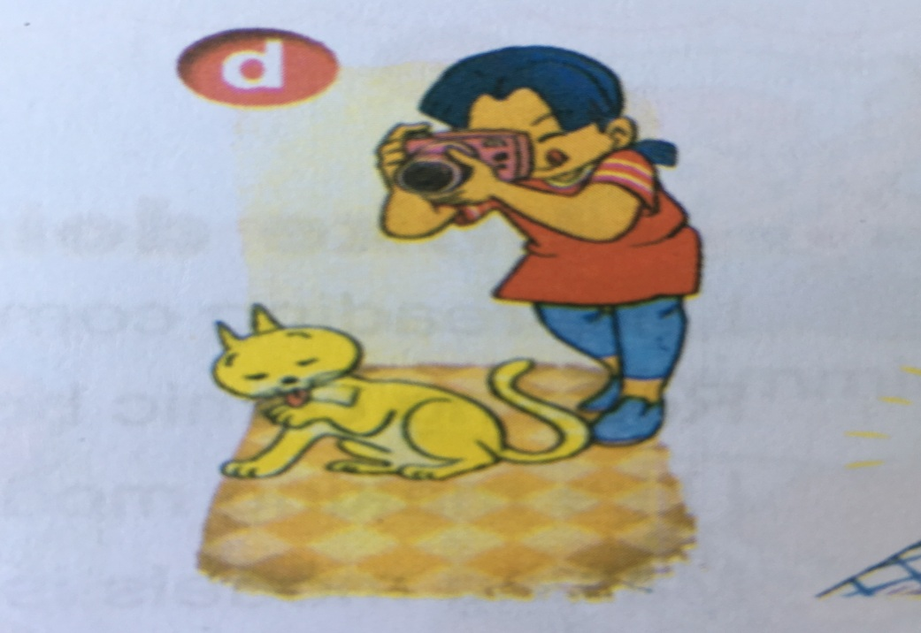
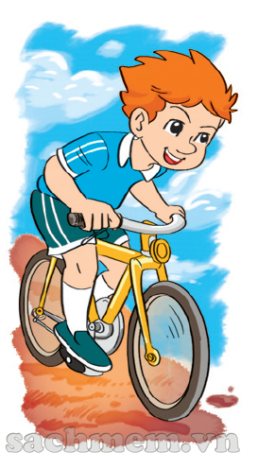
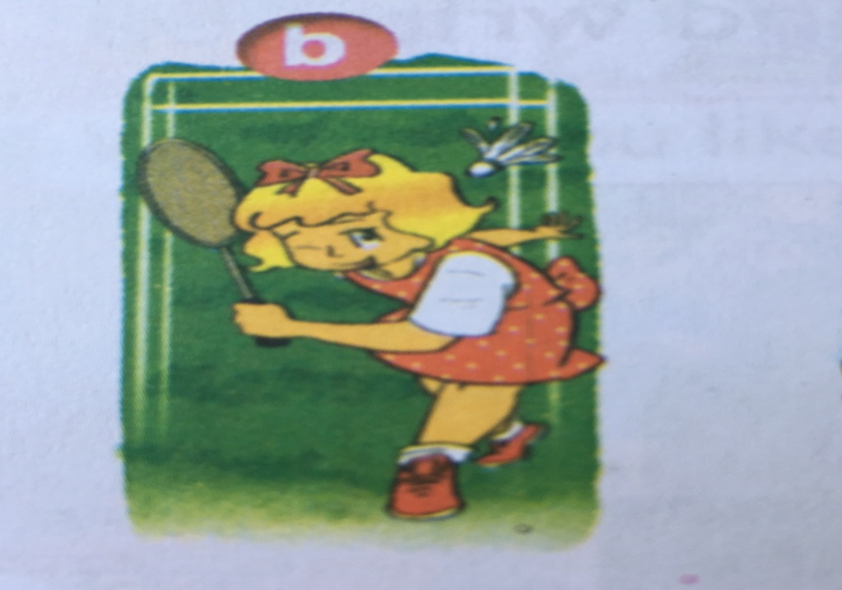
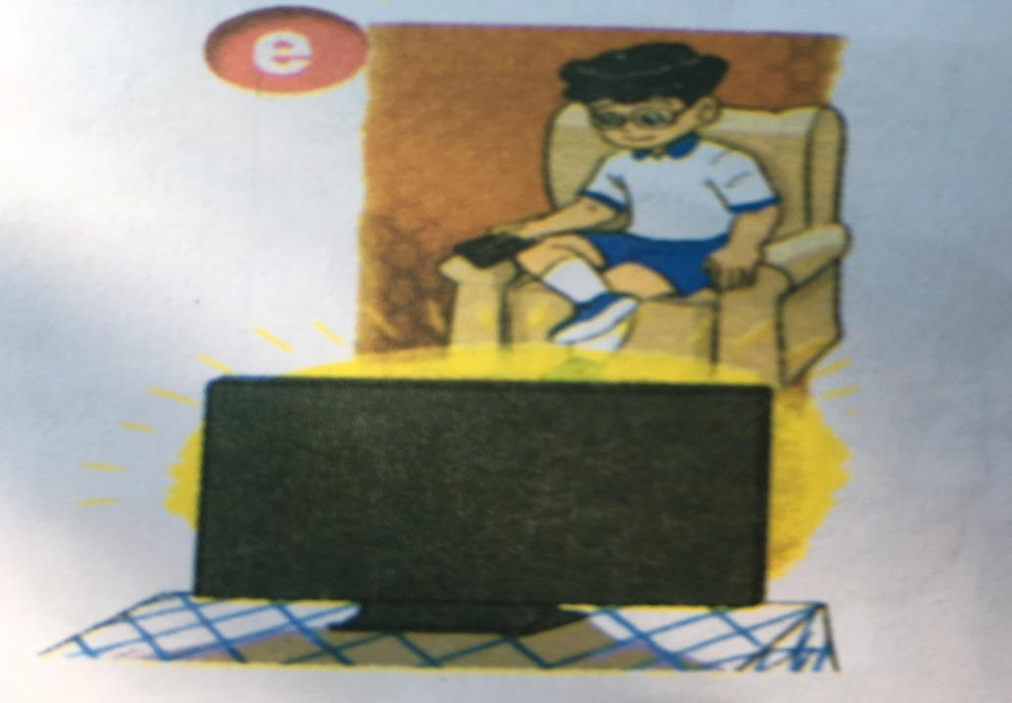
P. 48
Unit 7: What do you like doing?
Lesson 2: Part: 1-2- 3
1. Look, listen and repeat.
2. Point and say.
- riding a bike
- playing badminton
- flying a kite
- taking photos
- watching TV

Slide 6
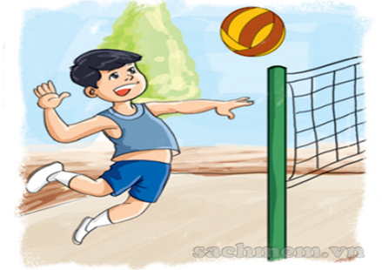
P. 48
Unit 7: What do you like doing?
Lesson 2: Part: 1-2- 3
1. Look, listen and repeat.
2. Point and say.
* Sentence patterns:
Asking and answering about someone’s hobbies:
What’s your hobby?
I like …………......... .
voleyball

Slide 7
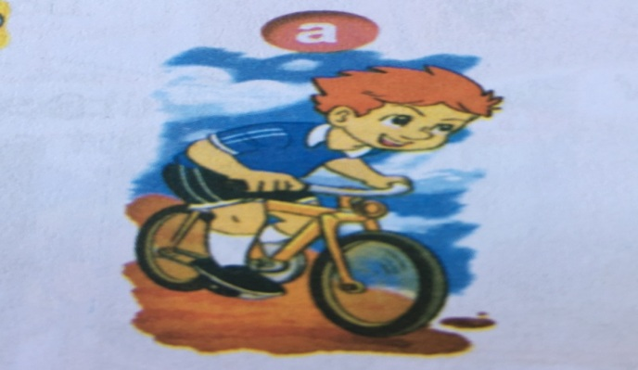
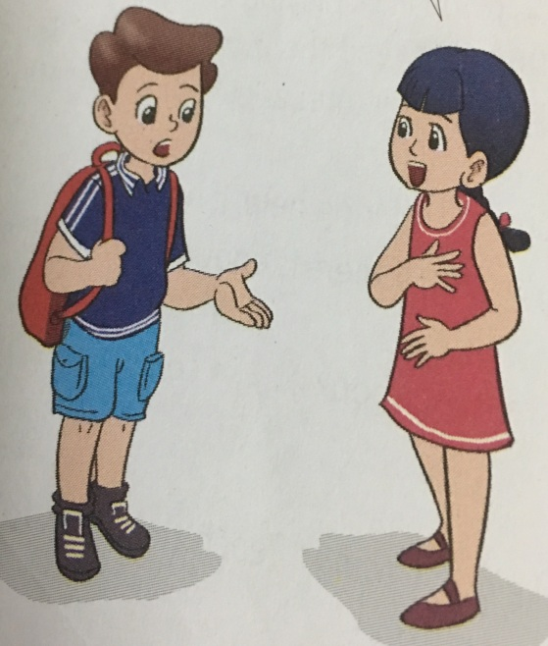
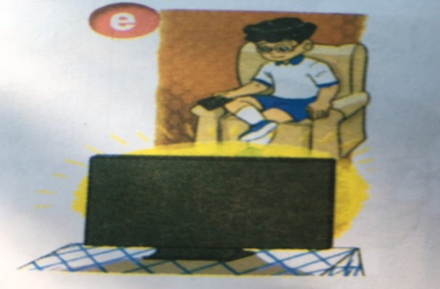
P. 48
Unit 7: What do you like doing?
Lesson 2: Part: 1-2- 3
1. Look, listen and repeat.
2. Point and say.
What’s your hobby?
→ I like ……...
riding a bike
playing badminton
taking photos
flying a kite
watching TV

Slide 8
P. 48
Unit 7: What do you like doing?
Lesson 2: Part: 1-2- 3
1. Look, listen and repeat.
2. Point and say.
3. Let’s talk.
- What do you like doing?
- What’s your hobby?
swimming
swimming
→ I like.....................
→ My hobby is ……................
Example:
playing chess - playing football
playing badminton - riding a bike
taking photos - watching tv
drawing a pictures - singing a song
collecting stamps - playing the piano

Slide 9
Game
Who is faster?

Slide 10
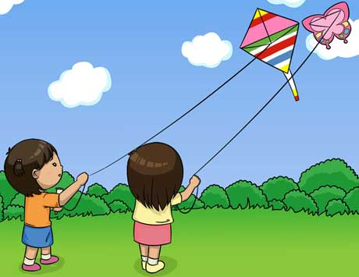
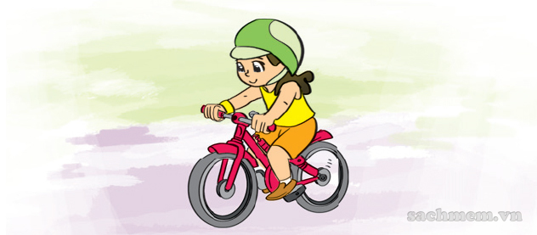
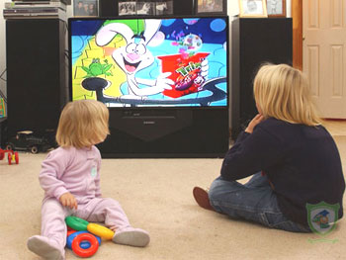
Look at the picture and fill in the gap
flying
I like……… a kite
2.I like……… .. a bike
3. I like………….. TV
4.I like…………. badminton
5.I like……… . photos
riding
watching
playing
taking

Slide 11
P. 48
Unit 7: What do you like doing?
Lesson 2: Part: 1-2- 3
Consolidation
* New words:
- riding a bike
: đi xe đạp
- playing badminton
: chơi cầu lông
- flying a kite
: thả diều
- taking photos
: chụp hình
- watching tv
: xem ti vi
* Sentence patterns:
Asking and answering about someone’s hobbies:
What’s your hobby?
→I like …………........

Slide 12
P. 48
Unit 7: What do you like doing?
Lesson 2: Part: 1-2- 3
Homework
Learn new words.
Practice asking and answering the questions about hobbies.
Prepare unit 7 – lesson 2 (4,5,6).

Slide 13
Goodbye. See you later!
Thank you very much!

