Slide 1
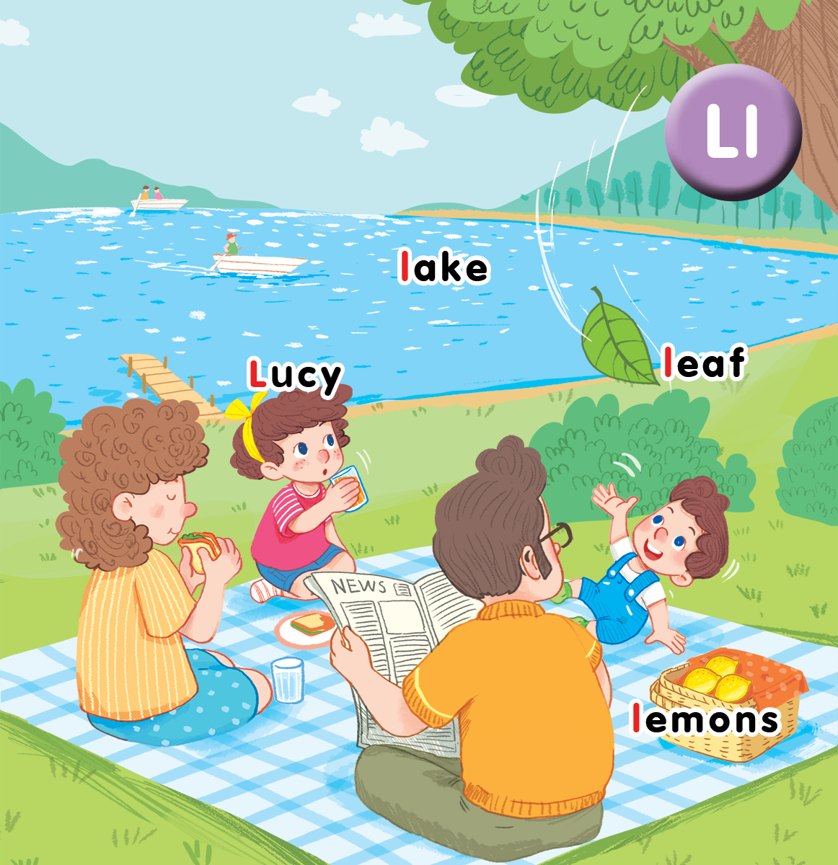
Unit 12 At the lake Lesson 2
Notes:
By the end of the lesson, pupils will be able to:
- say the sound of the letter L/l and the words Lucy, lake, lemons in a chant.
- listen, recognize the words and tick the correct boxes.
- write the letter L/l and complete the words __ucy, __ake, __eaf and __emons.

Slide 2
Warm-up
Notes:
Game: Who’s faster
Goal: Warm up and revise the unit keywords.
Time: 5 minutes
Give each group a set of words (teacher can use words of recent lessons).
Say Find words with letter L
Pupils will find words having letter L then stick on board.
The fastest is the winner.
Have pupils say all the correct words found.

Slide 3
Listen and chant
Notes:
Listen and chant is divided into 3 steps.
Step 1
Goal: Pupils will be able to read the chant lyrics.
Time: 5 minutes.
Have pupils read the chant lyrics in chorus, then in groups.
Step 2
Goal: Pupils will be able to listen, chant and clap along.
Time: 3 minutes
Play the recording, have pupils listen and clap along.
Play the recording, have pupils listen, clap and chant along
+ Round 1. Have pupils listen and clap along.
+ Round 2. Have pupils listen and do the TPR actions with teacher.
+ Round 3. Have pupils listen and do the actions and chant along.
+ Repeat round 3 several times.
Step 3
Goal: Pupils will be able to chant and clap along in pairs.
Time: 3 minutes
Have pupils chant along in pairs.

Slide 4
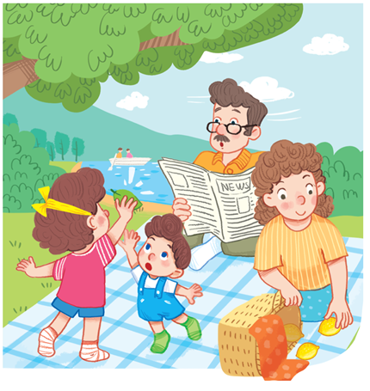
Chant!
L, l, Lucy.
L, l, lake.
L, l, lemons.
Look at Lucy.
Look at the lake.
Look at the lemons.

Slide 5
Listen and tick
Notes:
Listen and tick is divided into 2 steps.
Step 1
Goal: Pupils will be able to listen and choose the correct pictures.
Time: 5 minutes
Say Listen and tick with the TPR actions.
Play the recording and demonstrate the example.
Play the recording and have pupils do the task.
Step 2
Goal: Check
Time: 3 minutes
Play the recording and have pupils say the answer.
Play the recording again and have pupils repeat then give correct answer.

Slide 6
Listen and tick

Slide 7
Look, trace and write
Notes:
Goal: Pupils will be able to trace the letter.
Time: 5 minutes
Have pupils write the word by air tracing and say the word.
Demonstrate how to trace the word and have pupils do the task.

Slide 8
Game
Notes:
Slap the slide
Goal: Revise the words
Time: 5 minutes
Have pupils slap the slide and say the words. For example: L, L, Lucy.

Slide 11
Goodbye
Notes:
Say goodbye Lucy in chorus.

Slide 12
Goodbye
Notes:
Say goodbye lake in chorus.

Slide 13
Goodbye
Notes:
Say goodbye leaf in chorus.

Slide 14
Goodbye
Notes:
Say goodbye lemon in chorus.

